Slide 1
Revision Record
Don’t Print This Page
COURSE CODE
PRODUCT
PRODUCT VERSION
COURSE VERSION
< COURSE CODE >
< PRODUCT NAME >
< VXXXRXXX >
1.01
DEVELOPER / MODIFIER
DATE
APPROVER
NEW / UPDATE
Nagaraj G
20111012
NEW

Slide 2
UAP Maintenance Station Installation

Slide 3

Agenda
UAP Maintenance Station Introduction
UAP Maintenance Station Server Installation
UAP Maintenance Station Client Installation
25-Jul-12

Slide 4
Objectives
Upon completion of this course, you will be able to:
Installation of UAP Maintenance Station Server and Client in windows OS
Page4

Slide 5

Target Audience
This course has been designed for audience who requires knowledge on UAP Maintenance Station Tool and its installation.
Page5

Slide 6
Installation Pre Requisites
IP Address Planning
Network Planning
Operating system planning and availability
Hardware Planning

Slide 7
Agenda
UAP Maintenance Station Introduction
UAP Maintenance Station Server Installation
UAP Maintenance Station Client Installation
References
25-Jul-12
Page7

Slide 8

UAP Maintenance Station Introduction
The UAP Maintenance Station is used for installation, configuration, upgradation, patch management etc.., of UAP3300 & can implement the following functions:
Configuration: This function implements the configuration and modification of office data, including:
Offline configuration
Online configuration
Installation
Upgrade and rollback
Capacity extension
Hot patch management
Office and user management
Trace: This function implements the tracing of the SIP, PRA, SS7, and INTESS protocols.
Alarm: This function implements the Verify, Clear, Syn, Save, and Status operations on the alarm information reported by the UAP3300.
Monitor: This function implements the monitoring of the real-time resource statuses of the UAP3300, such as the CPU status and E1 status.
Log Server: This software is used to collect the service interaction logs, resources, trunk-related logs, log files in the MRSLOG folder of the file server, and disconnection statistics
Notes:
Configuration: Configuration of UAP3300
Installation : Installation of UAP3300
Upgrade & Rollback: Upgradation and rollback of UAP3300
Hot patch Management: To the existing running system, if any patch needs to be added. This option to be used.

Slide 9
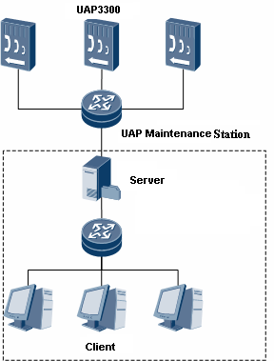
UAP Maintenance Station Structure
Adopts the C/S structure, which consists of a server and multiple clients.
One server maps multiple clients, and multiple clients can simultaneously configure, monitor, and trace the data in multiple offices.
The UAP Maintenance Station Server is the core component.
Responsible for interacting with the UAP and processing the requests of clients.
The UAP Maintenance Station client interacts with UAP Maintenance Station server.
Server Supports Windows OS & Linux OS. Client only Windows OS.

Slide 10
Agenda
UAP Maintenance Station Introduction
UAP Maintenance Station Server Installation
UAP Maintenance Station Client Installation
References

Slide 11

UAP Maintenance Station Server Installation
Step 1: Obtain the Installable for UAP Maintenance station Server and Client from Huawei Support site.
Step 2: Double-click server_setup.exe to install the UAP maintenance Station Server. The installation wizard dialog box is displayed

Slide 12
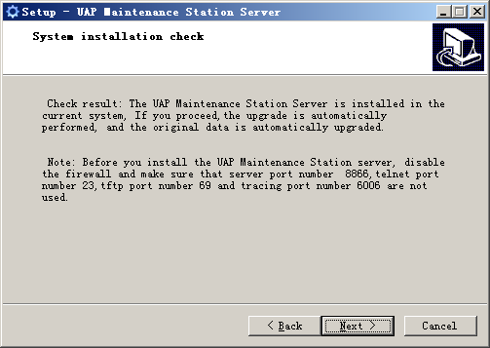
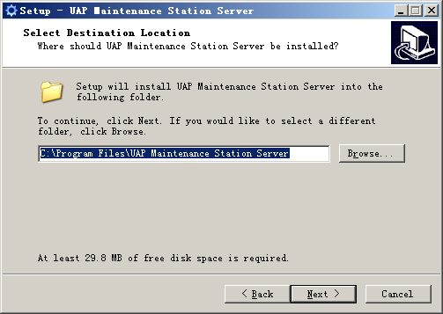
UAP Maintenance Station Server Installation
Step 3: Click Next
Step 4: Select the path to install
or Retain the default path

Slide 13
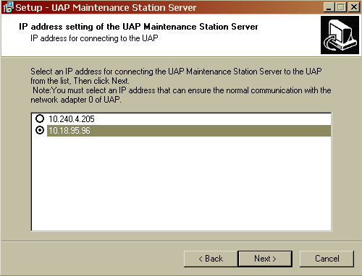
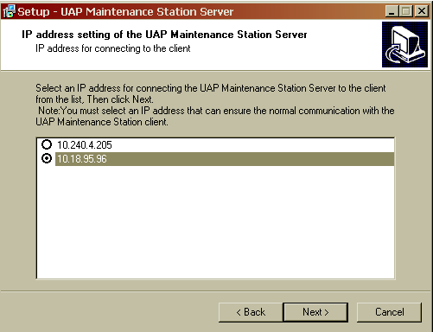
UAP Maintenance Station Server Installation
Step 5: Select NEXT
Step 6: Select the IP Address of Client
and select NEXT
Notes:
Client IP address for connecting to UAP:
By default there will be One IP Address, other will be the IP Address of the machine. Because the client, server can be in different machine. Later when the client is installed, we can input the server IP address of the server to login.
UAP: BY default there will be 2 IP address. Select the Local IP. Once the Client is installed. We can configure the UAP with its correct IP Address

Slide 14
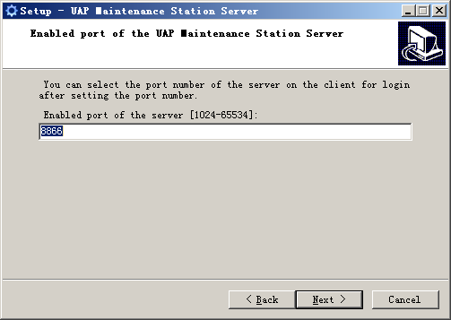
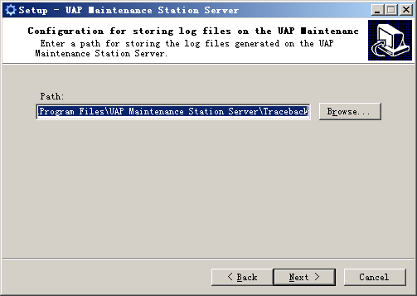
UAP Maintenance Station Server Installation
Step 7: Default port
Select NEXT
Step 8: Default installation path
Select NEXT

Slide 15
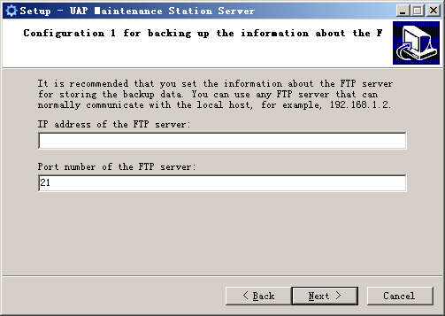
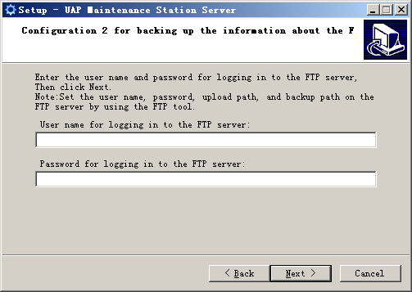
UAP Maintenance Station Server Installation
Step 9: Enter FTP Server IP Address. Select NEXT
Step 10: Enter User Name and password of FTP server to login. Select NEXT
Note: FTP Server IP Address is optional
Notes:
The installation package is uploaded from the FTP server. Also, while taking the backup of UAP Configuration data, the backup is created in the FTP server location

Slide 16
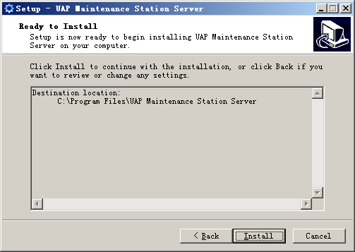
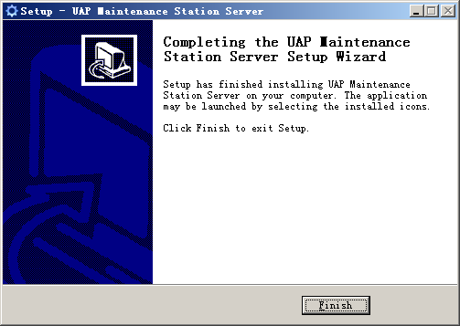
UAP Maintenance Station Server Installation
Step 11: Select Install
Step 12: Select Finish to complete
the installation

Slide 17

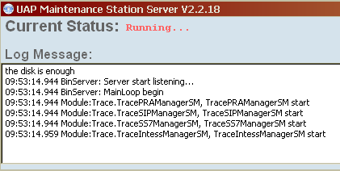
Server Installation Verification
Choose Start > All programs > UAP Maintenance Station Server > UAP Maintenance Station Server to start the UAP Maintenance Station server.
If the icon is displayed in the status bar at the lower right corner of the desktop, it indicates that the UAP Maintenance Station Server is installed correctly. Double click on the icon to see the below screen.

Slide 18
Agenda
UAP Maintenance Station Introduction
UAP Maintenance Station Server Installation
UAP Maintenance Station Client Installation
References
25-Jul-12
Page18

Slide 19

UAP Maintenance Station Client Installation
Step 1: Obtain the Installable for UAP Maintenance station Client
Step 2: Double-click client_setup.exe to install the UAP maintenance Station Client. The installation wizard dialog box is displayed

Slide 20
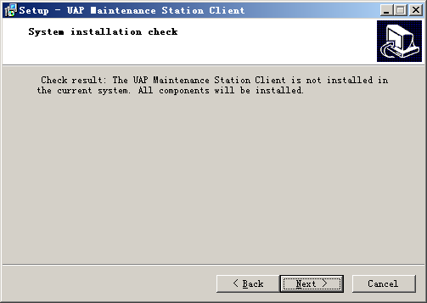

UAP Maintenance Station Client Installation
Step 3: Select Next
Step 4: Browse Installation path
Select Next

Slide 21
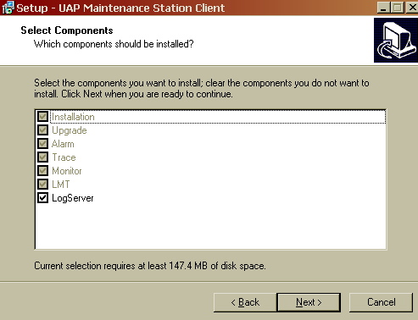
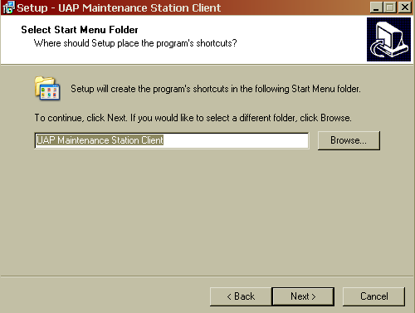
UAP Maintenance Station Client Installation
Step 5: Select the required
components to install
Select Next
Step 6: Browse Installation path
Select Next
Notes:
Configuration
This function implements the remote centralized installation, upgrade, rollback, expansion, configuration modification on the current network, and hot patch management on the UAP3300.
Monitoring
This function implements the remote monitoring to the UAP3300 on the current network, including the monitoring of board status, CPU status, E1 status, channel status, TTS status, trunk link status, component connection status, and SIP terminal status.
Alarm
This function is used to receive the UAP3300 alarm information in real time and provide the alarm clearance suggestion to locate and clear this alarm, thus ensuring the normal running of the call center.
Tracing
This function implements the tracing to the SIP signaling, SS7 signaling, PRA signaling, R2 signaling, and INtess protocol. After the tracing function is enabled, the client receives and displays the information reported from the UAP3300 in real time.
Log Server
This software is used to collect the service interaction logs, resources, trunk-related logs, log files in the MRSLOG folder of the file server, and disconnection statistics.

Slide 22
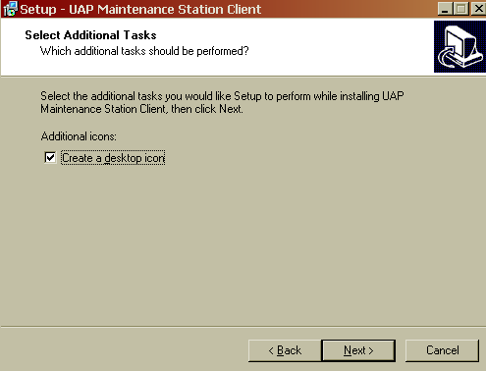
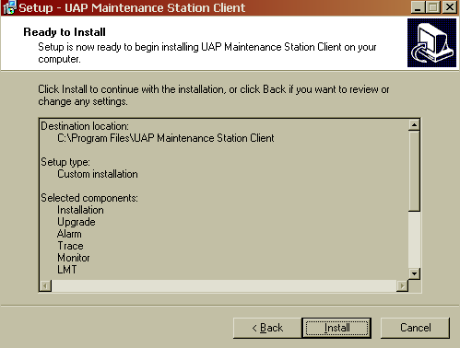
UAP Maintenance Station Client Installation
Step 7: Select Next
Step 8: Select Install

Slide 23
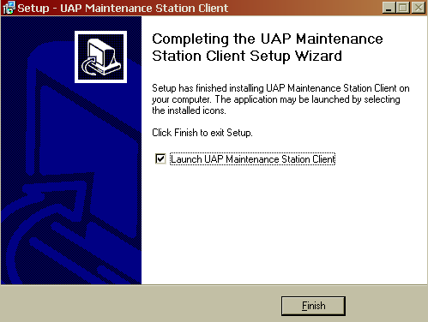
UAP Maintenance Station Client Installation
Step 10: Select Finish to complete the install and to launch
the Client application

Slide 24
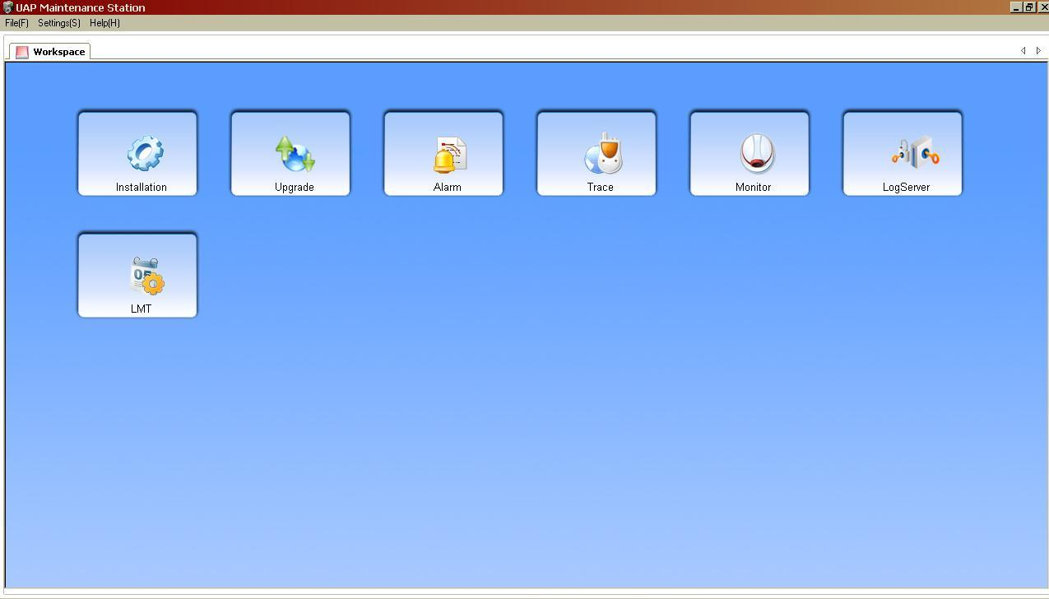
Client Installation Verification
After the installation is complete, if the workspace page is displayed as shown in figure below. It indicates that the UAP Maintenance Station Client is installed correctly

Slide 25
Agenda
UAP Maintenance Station Introduction
UAP Maintenance Station Server Installation
UAP Maintenance Station Client Installation
References
25-Jul-12
Page25

Slide 26
References
For Installation of UAP Maintenance station in Linux OS
UAP3300 V100R002C03SPC400 UAP Maintenance Station Installation Guide.zip
http://support.huawei.com/support/pages/kbcenter/view/product.do?actionFlag=detailProductSimple&web_doc_id=SE0000465853&doc_type=VersionDoc

